Slide 1

Chemical formulae , equation and calculation part (1)
I | II | III | IV | V | VI | VII | 0
Li+ | Be2+ | Al3+ |  | N3- | O2- | F-
Na+ | Mg2+ |  |  | P3- | S2- | Cl-
K+ | Ca2+ |  |  |  |  | Br-
Ag+ | Ba2+ |  |  |  |  | I-
 | Zn2+
NH4+ |  |  |  |  | SiO3(2-) | OH-
 |  |  |  |  |  | MnO4-
 |  |  |  |  |  | CH3COO-
Some polyatomic ions
NH4+ = ammonium ions
SiO3(2-)=silicate ions
OH-= hydroxide ions
MnO4-= manganate VII ions
CH3COO-= ethanoate /acetate ions

Slide 2
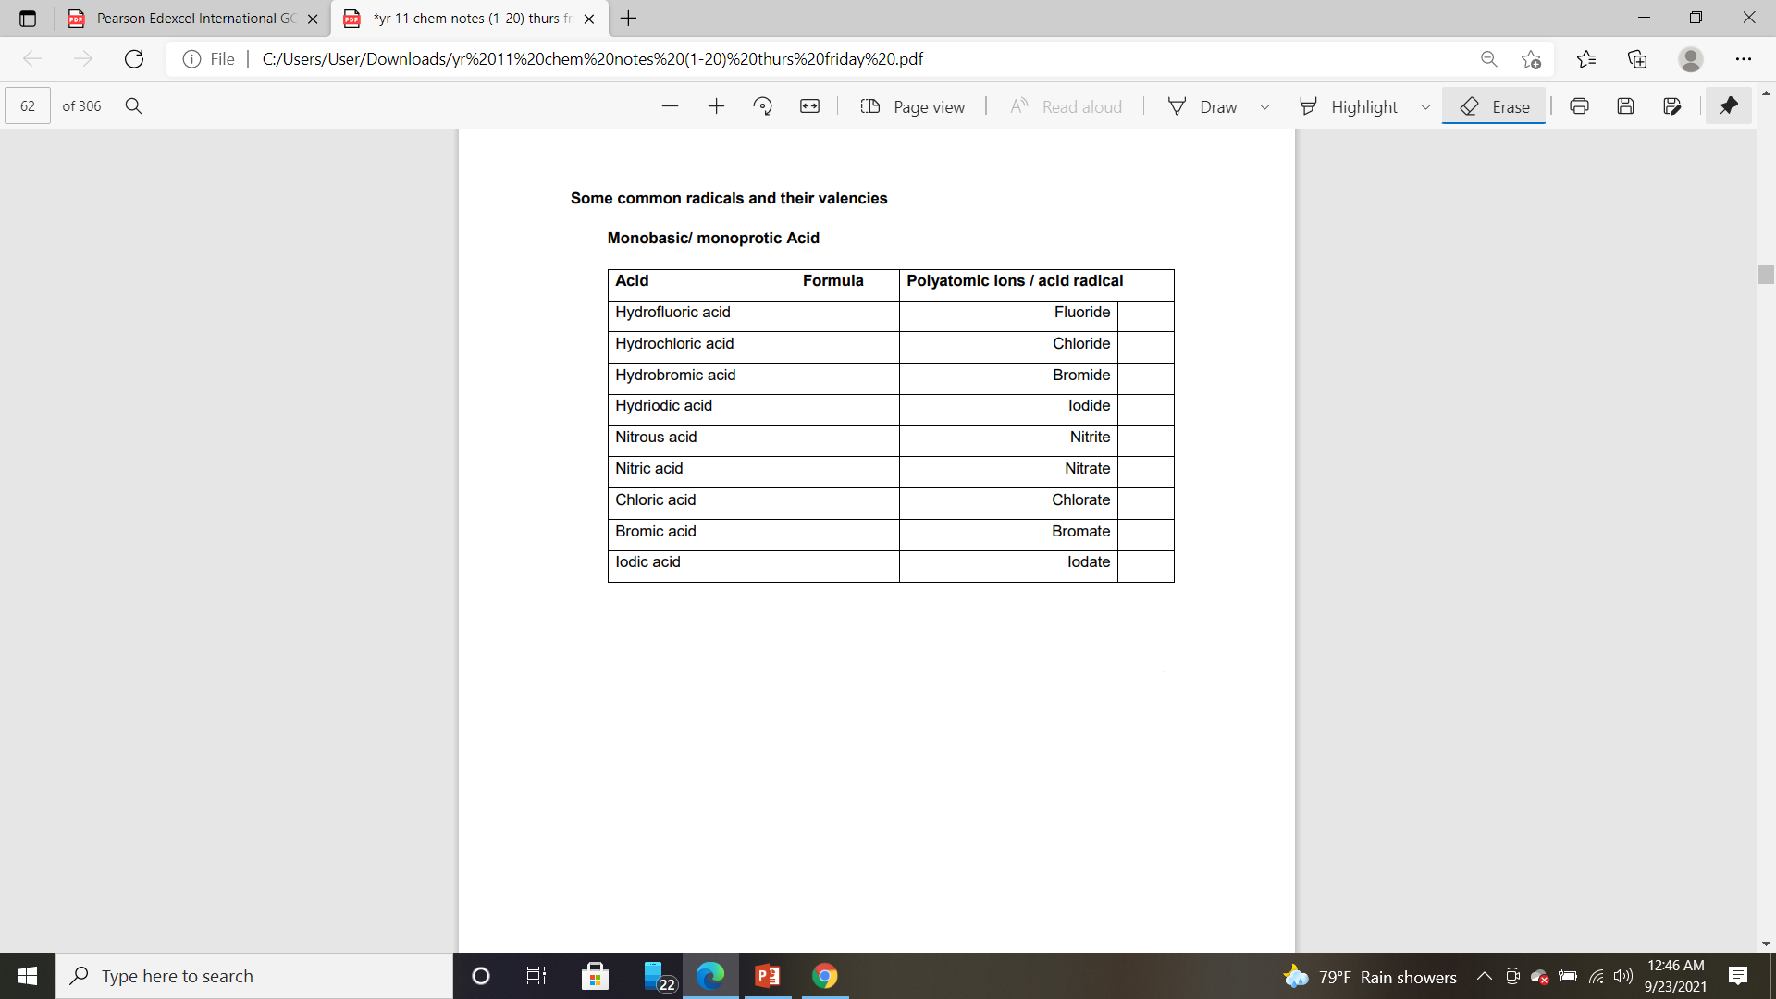

Slide 3
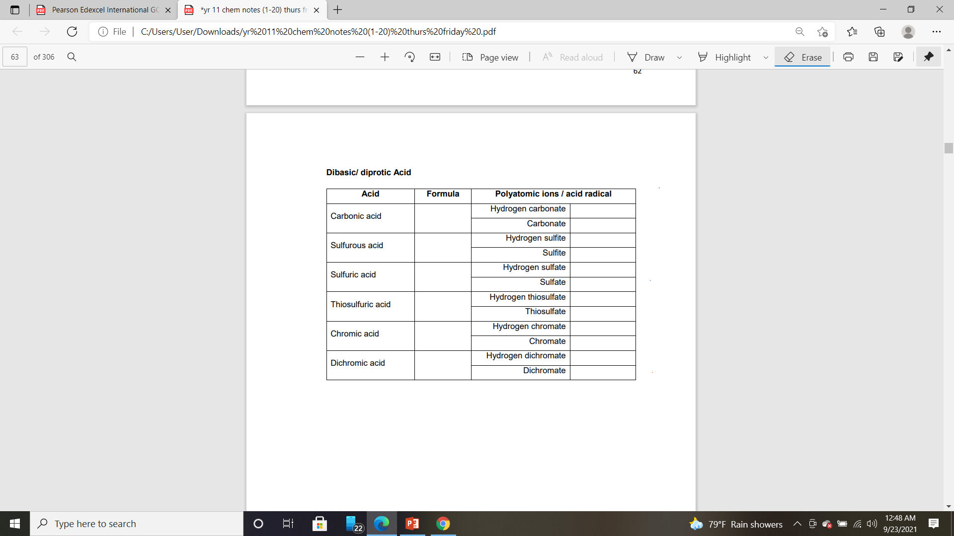

Slide 4
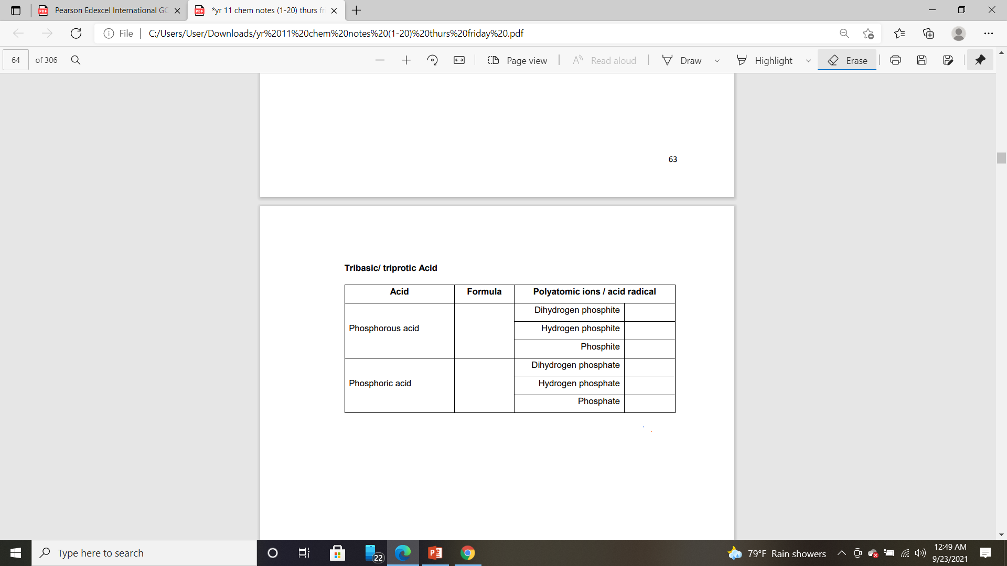

Slide 5
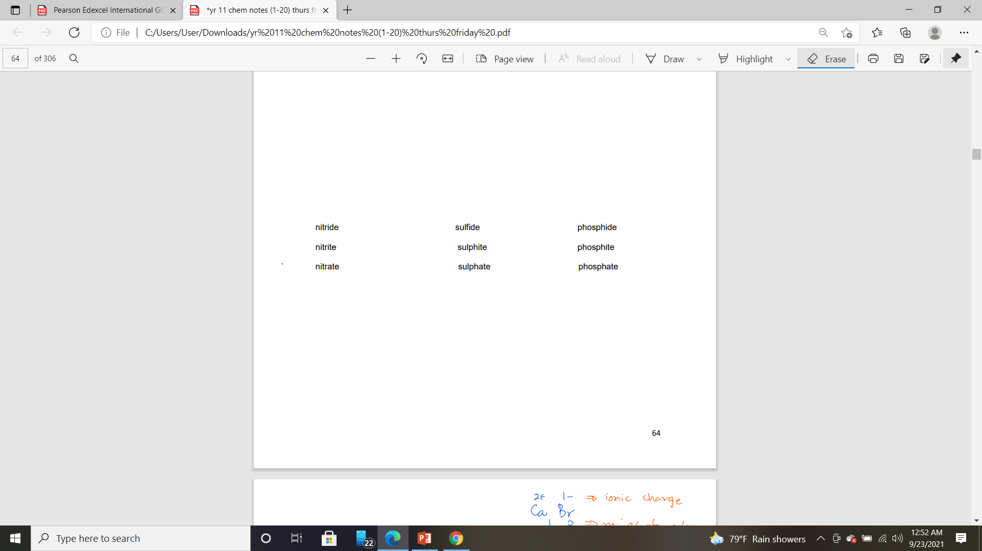

Slide 7
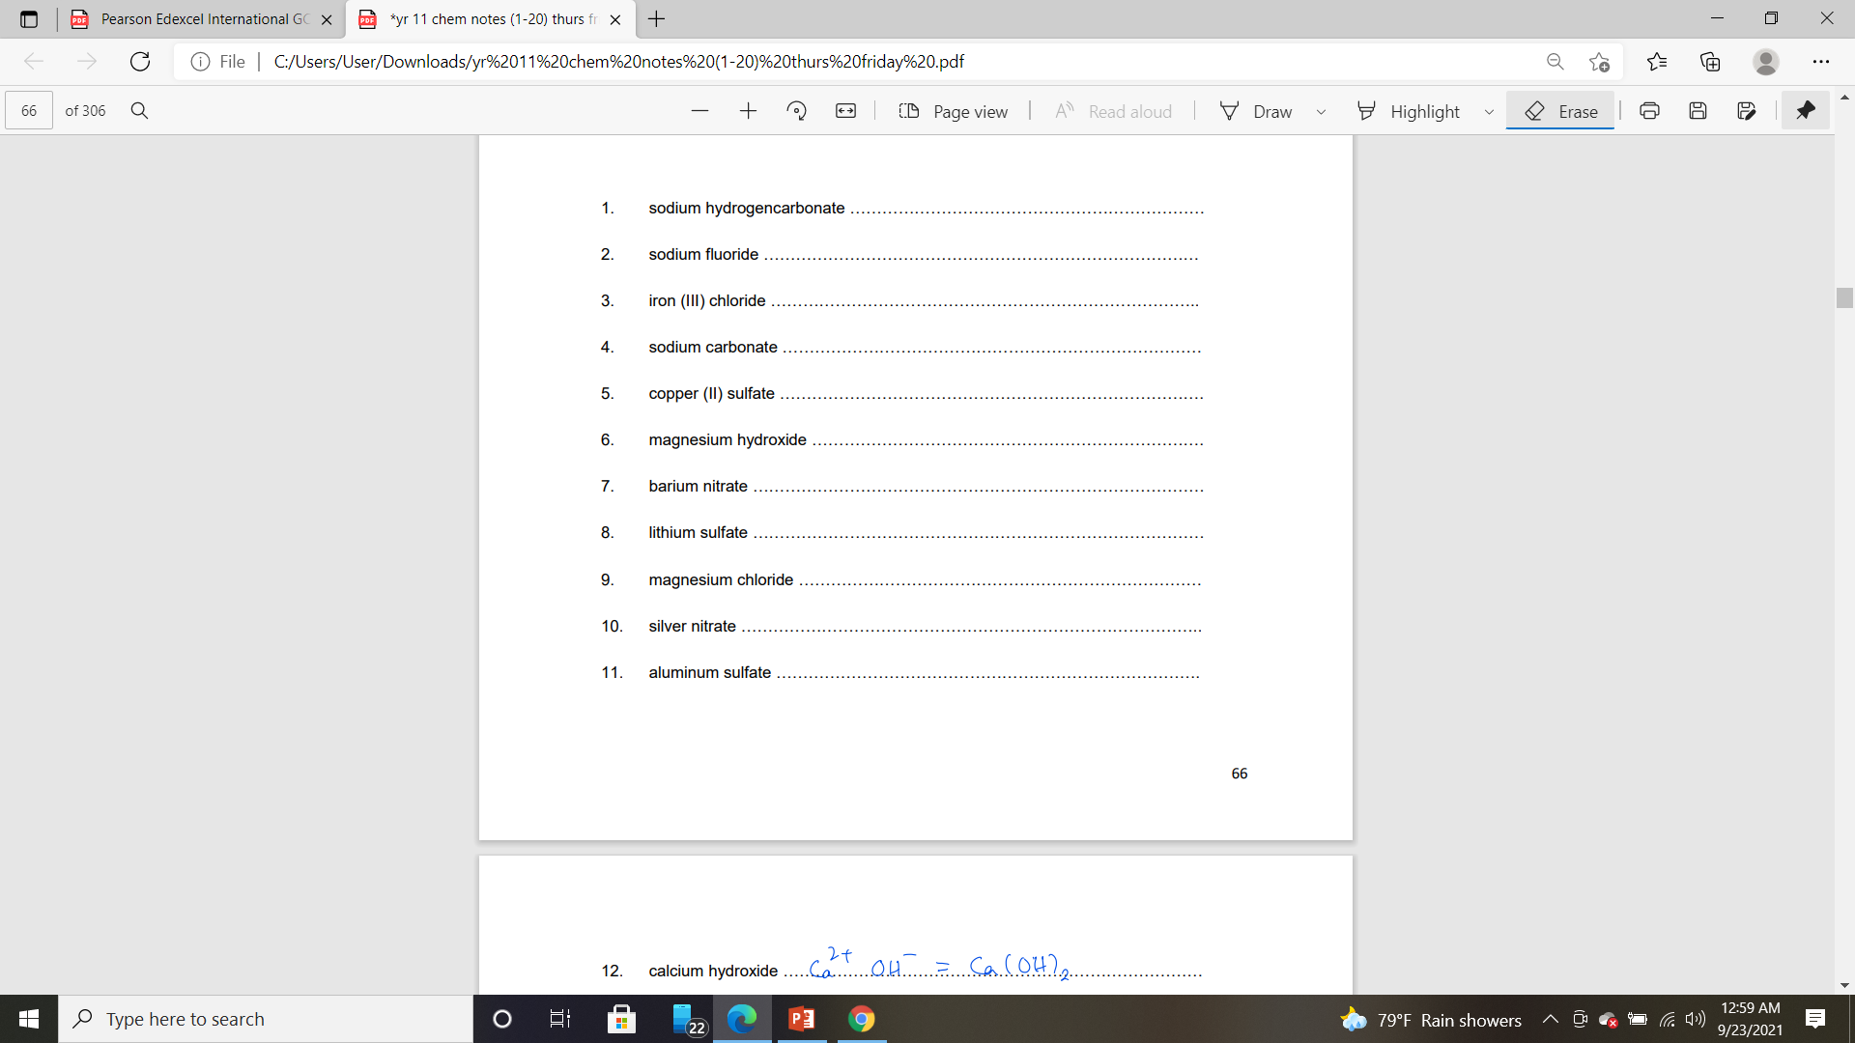

Slide 8
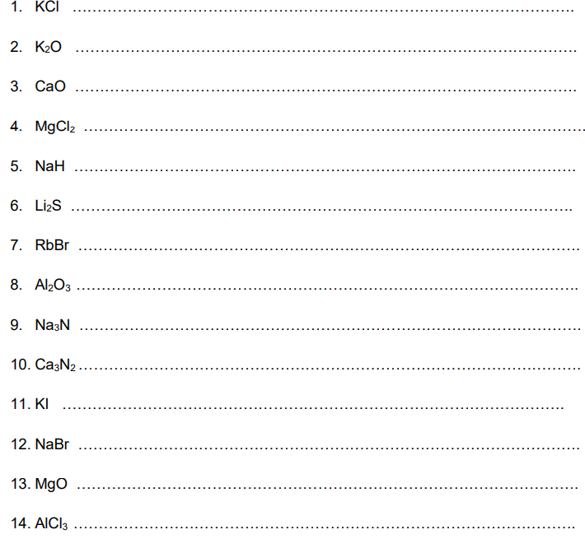

Slide 9
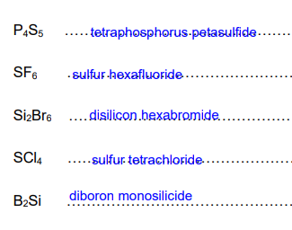
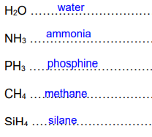
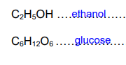

Slide 10

Chemical equations
Reactants Products
balance the metal first.
For groups of atoms (like SO4, NO3), we need to count individual atoms.
Leave the hydrogen and oxygen atoms to the last as they are always included in all chemical reactions.
Add suitable physical states( s , l , g , aq )

Slide 11
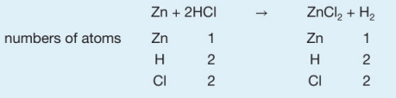

Slide 13
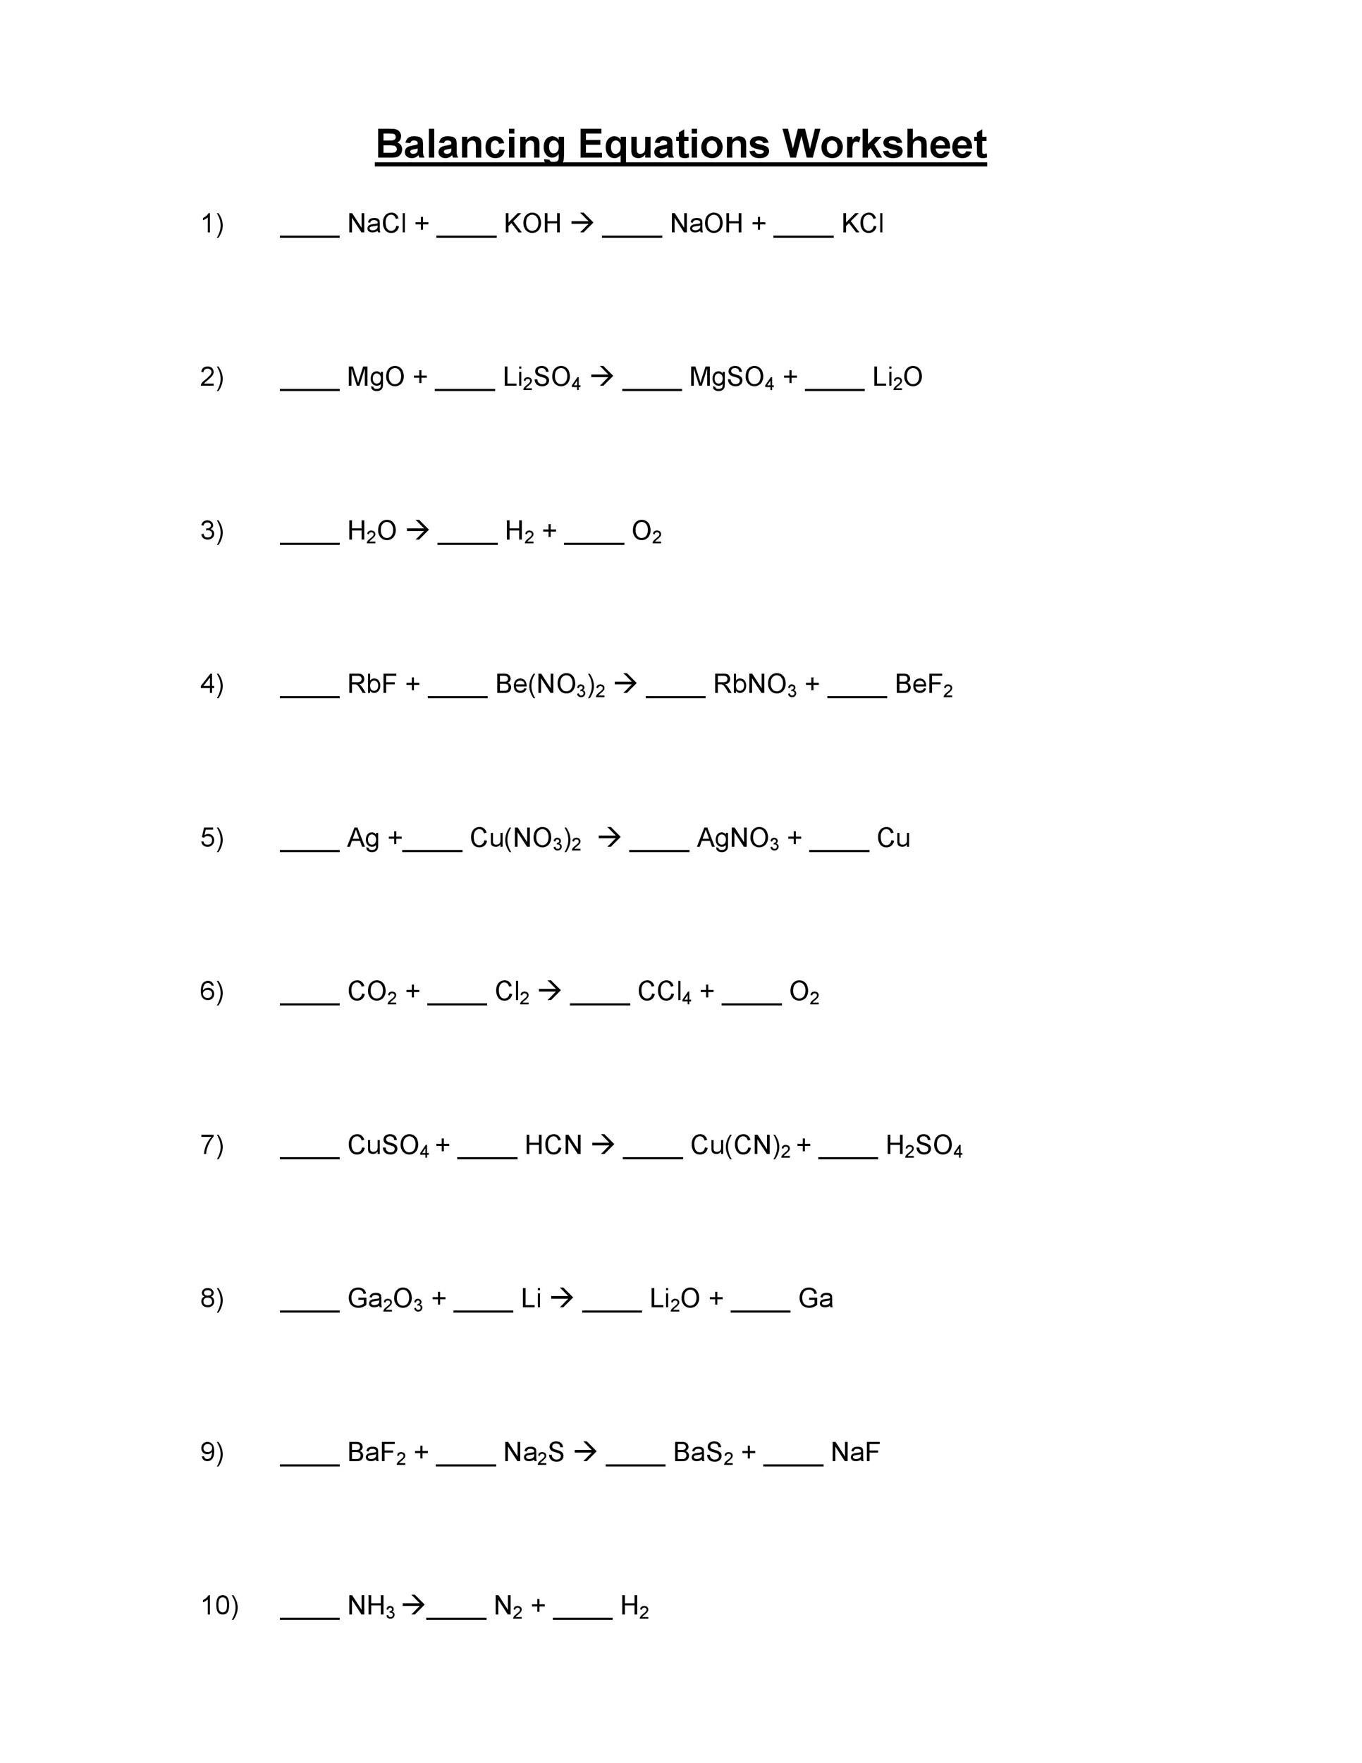

Slide 14
ionic equation
most ionic compounds and strong acids and alkalis dissociate completely into ions when dissolve in water.
The solid, liquid and gaseous chemicals are not formed ions in water.
Steps you have to follow in balancing ionic equations
Balance the number of atoms on both sides of the equation
Write the ions formed in the equation.
Omit spectator ions. (ions that do not take part in the reaction formed on both sides of equations).
Write down the physical states.
Check the net ions amount.

Slide 15

Examples(balancing ionic equations))
NaOH (aq) + Fe(NO3)3 (aq) Fe(OH)3 (s) + NaNO3 (aq)
3NaOH (aq) + Fe(NO3)3 (aq) Fe(OH)3 (s) + 3NaNO3 (aq)
Ionic equation
3Na+ + 3OH- + Fe3+ + 3NO3- Fe(OH)3 + 3Na+ + 3NO3-
Fe3+ (aq) + 3OH-(aq) Fe(OH)3(s)
Net ions
3+ + 3- = 0

Slide 16
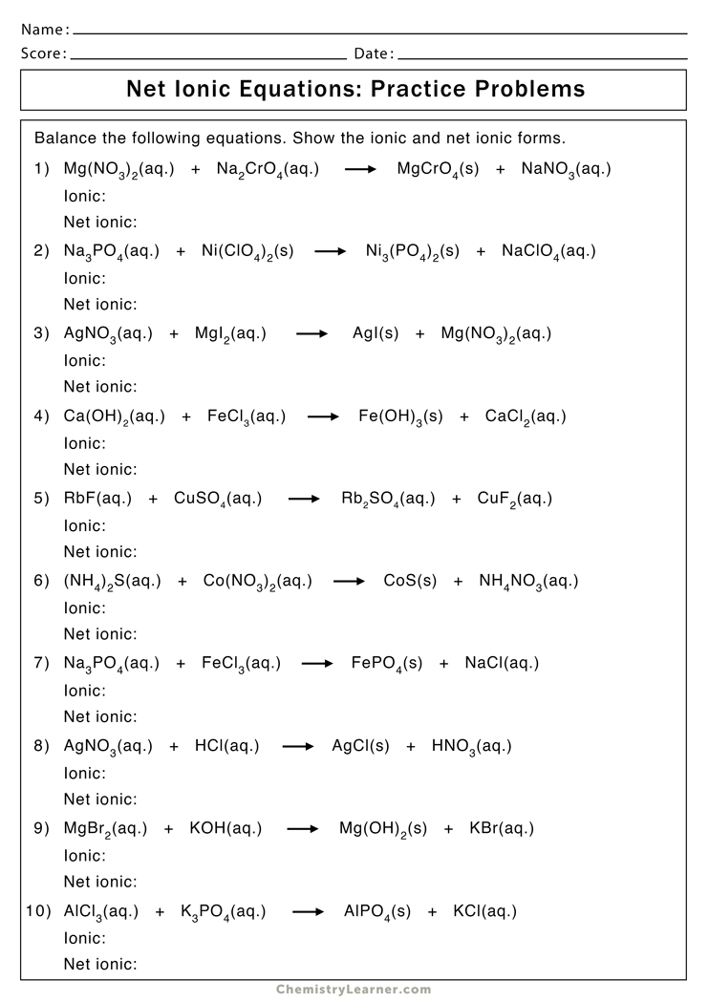

Slide 18
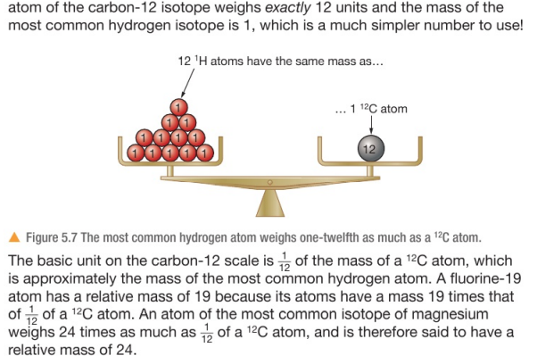
Relative atomic mass
Relative atomic mass (Ar):
The average mass of naturally occurring atoms of an isotopic element on a scale where the carbon-12 atom has a mass of exactly 12 units.

Slide 19
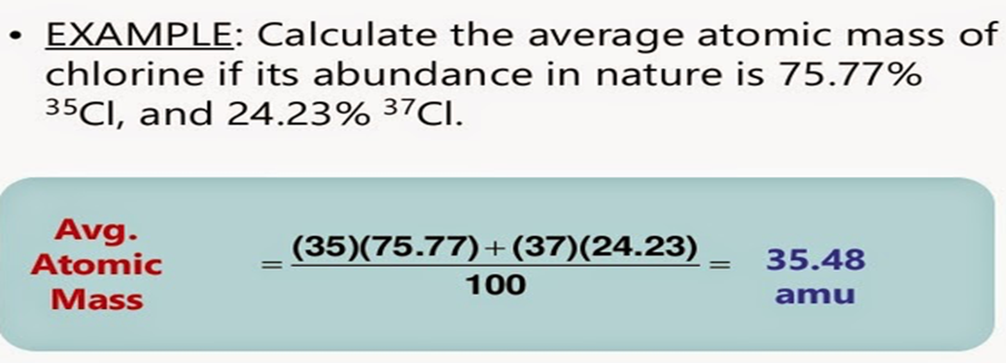

Slide 20
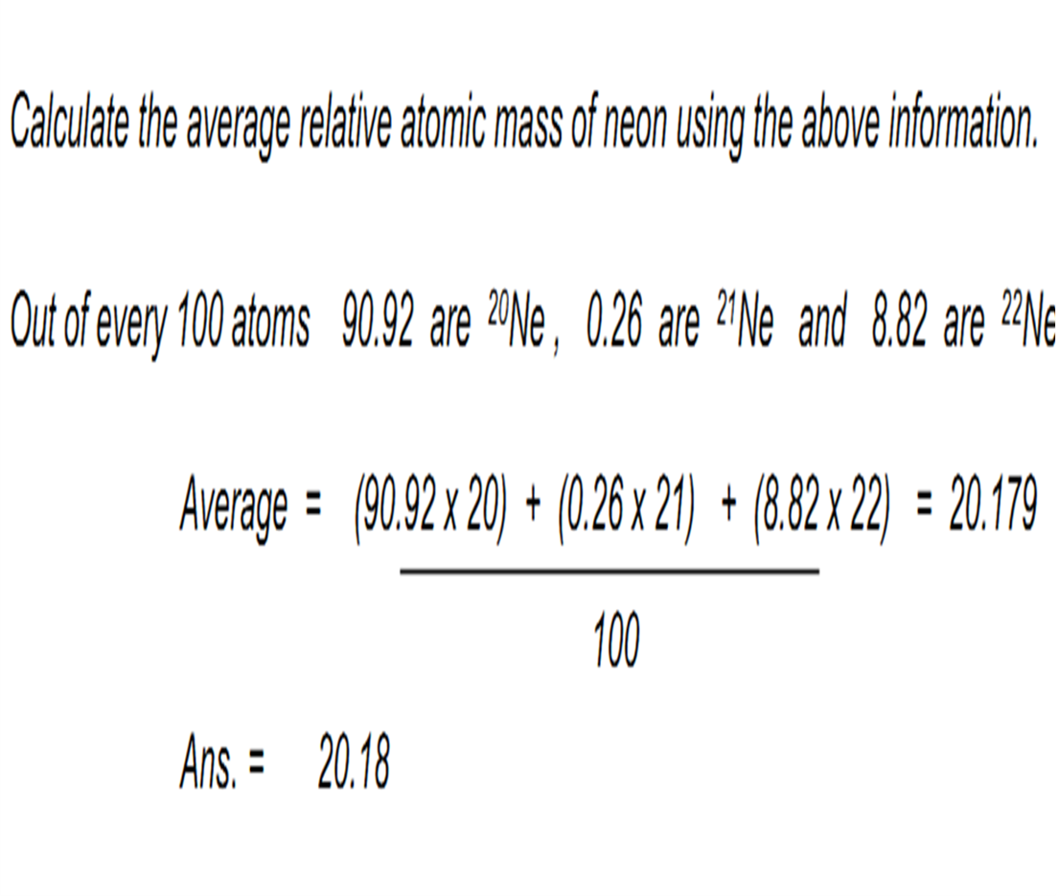

Slide 21
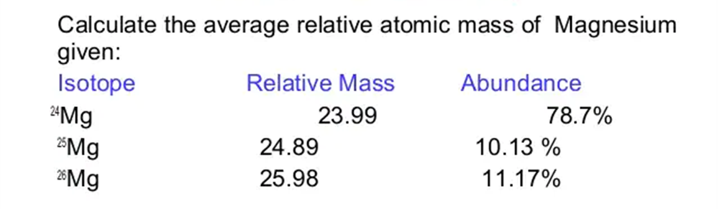
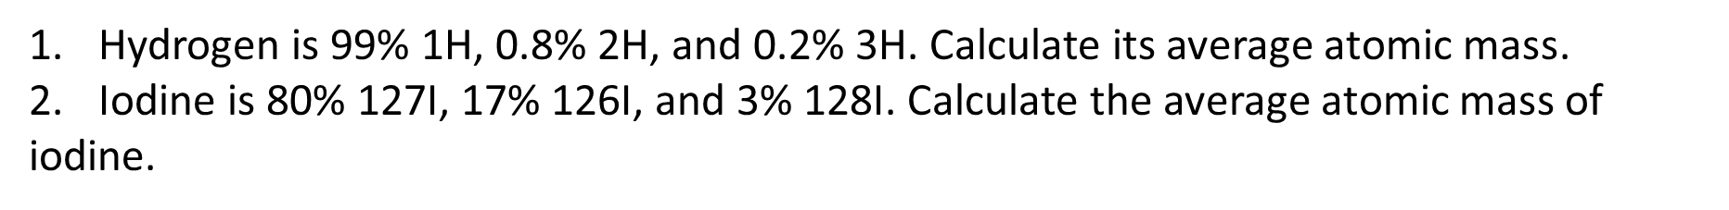

Slide 22
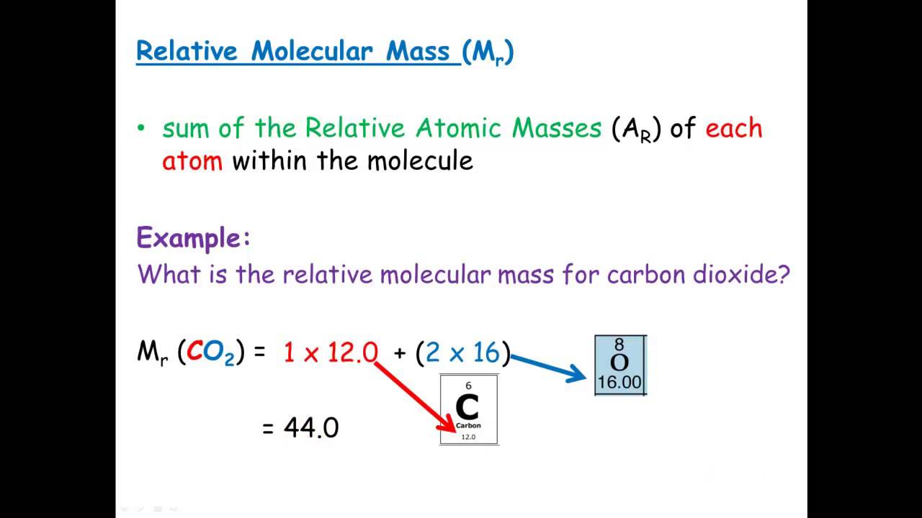
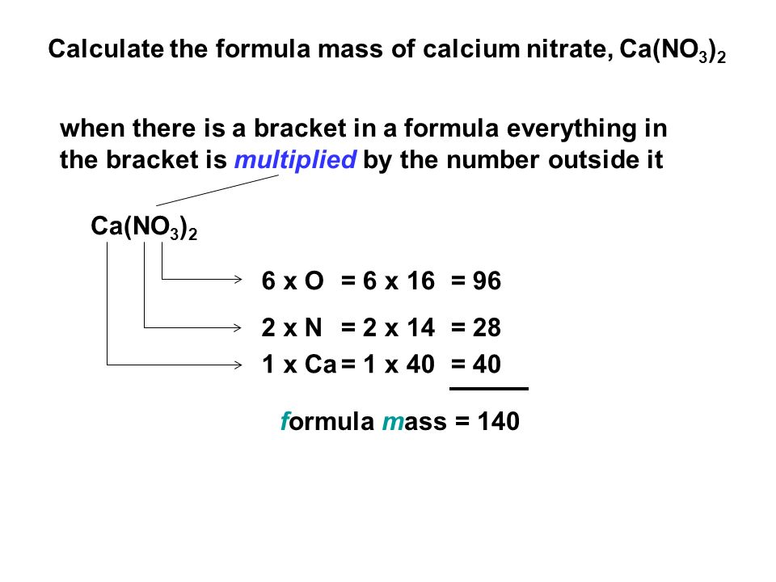
Relative molecular mass (Mr):
The sum of the relative atomic masses of all the atoms shown in the formula of a molecule.
Notes :relative formula mass (RFM) - ionic compound
relative molecular mass (RMM) - covalent compound

Slide 23
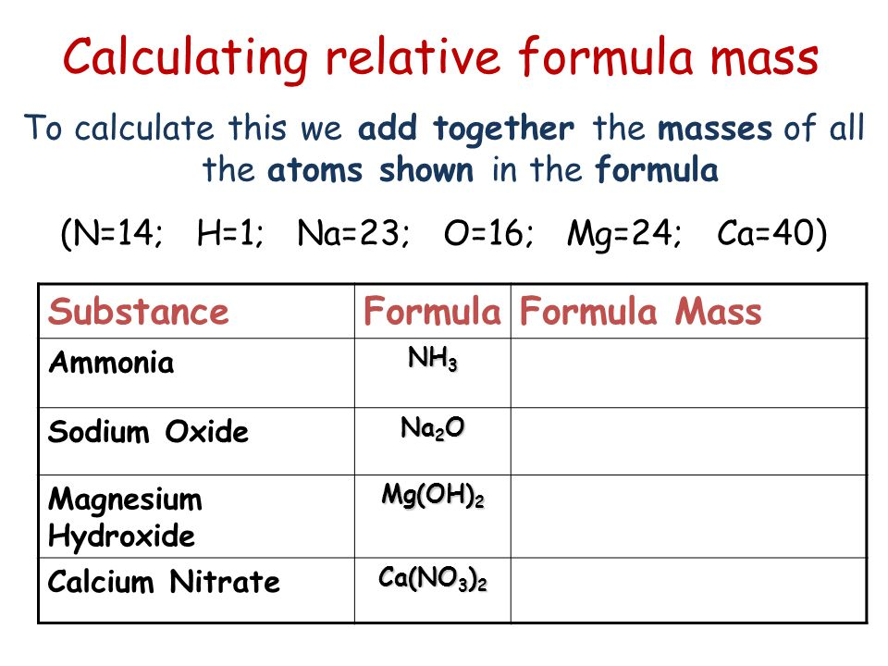
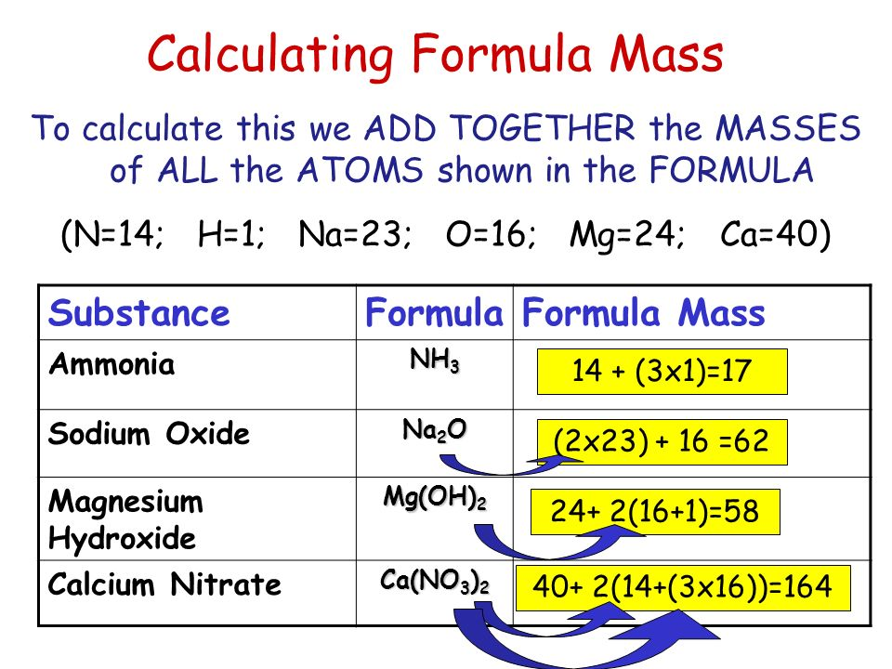

Slide 24
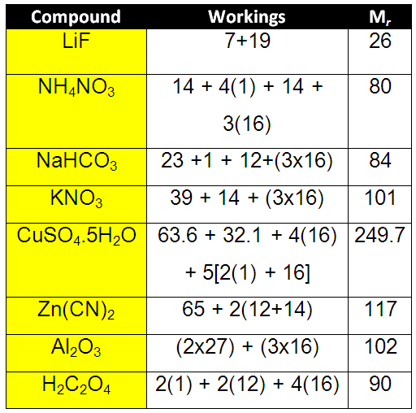

Slide 25
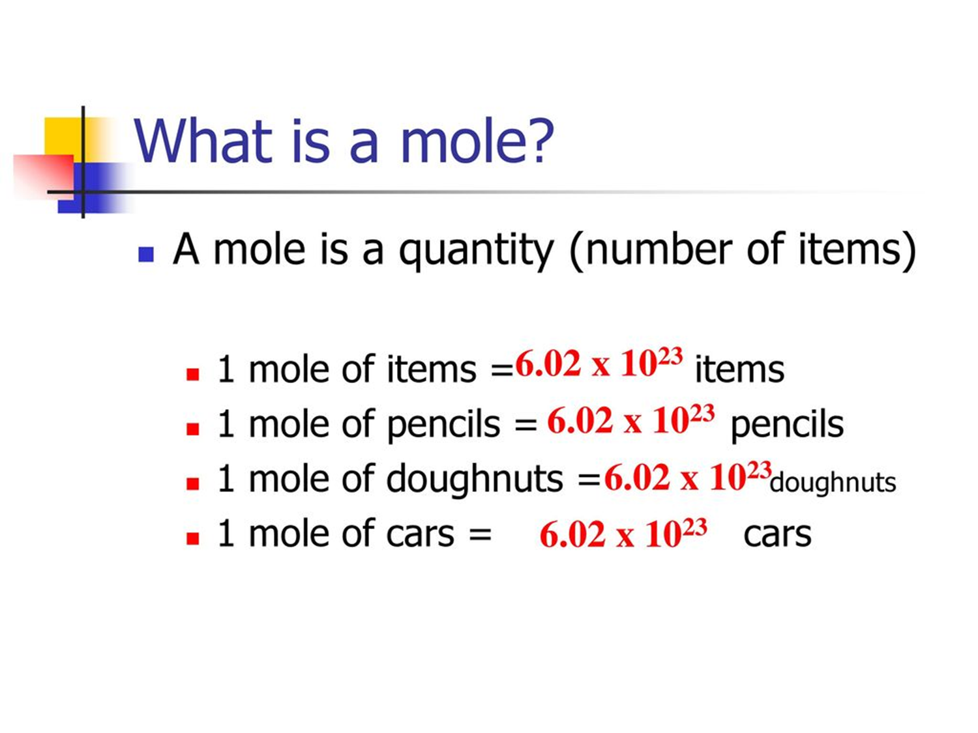
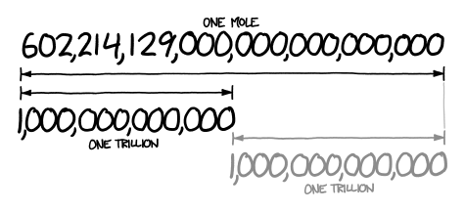
Avogadro Constant:
One mole of any substance contains 6 x 10*23 particles.
1 mole of a substance = 6 x 10*23 particles

Slide 26
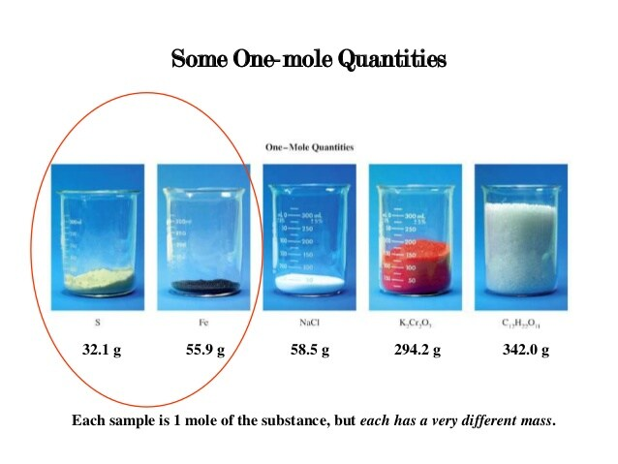

Slide 27
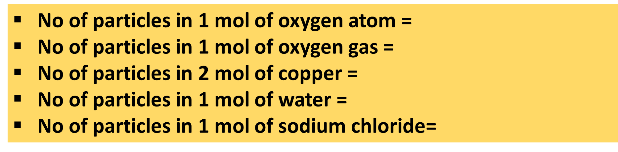

Slide 28
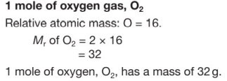
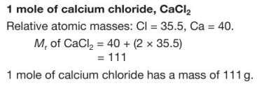
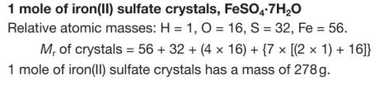

Slide 29
Molar mass:
The mass of 1 mole of a substance (molar mass) is the Ar or Mr in grams.
Molar mass of oxygen atom =
Molar mass of oxygen gas =
Molar mass of silver =
Molar mass of water =
Molar mass of calcium chloride =
Molar mass of copper (II) oxide =
Molar mass of sulfuric acid =
Molar mass of potassium dichromate =
Molar mass of ammonia =
Molar mass of potassium acetate =

Slide 30
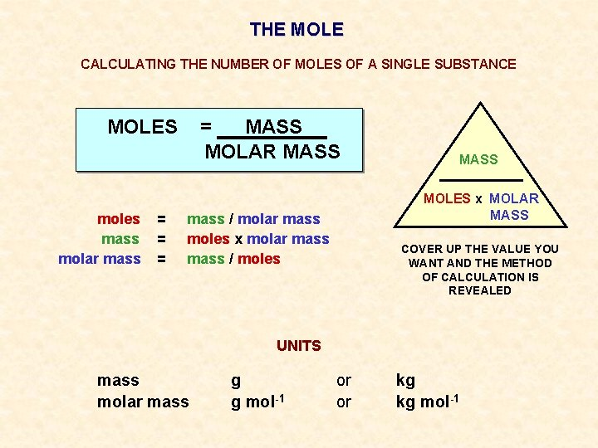

Slide 31
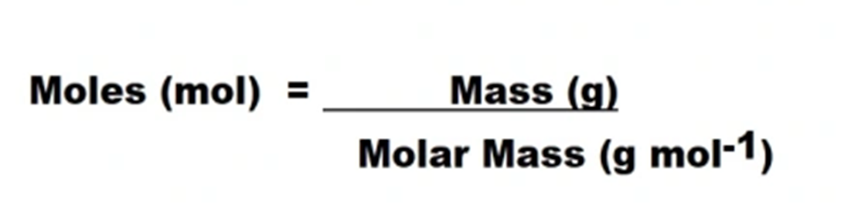
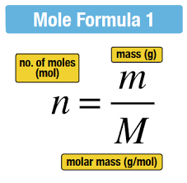

Slide 32
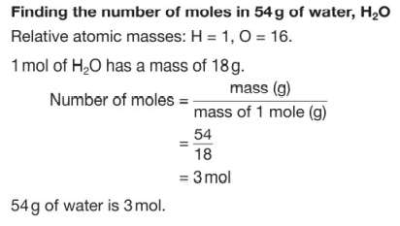
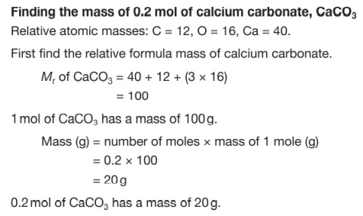

Slide 33
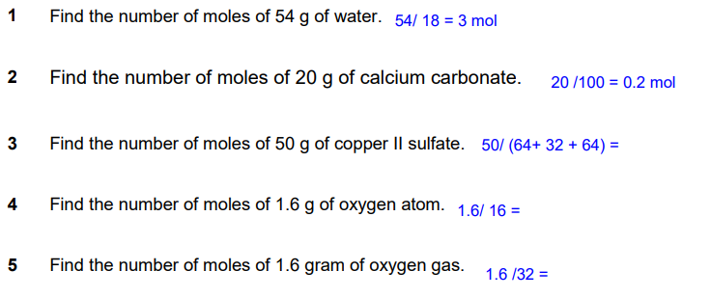

Slide 34
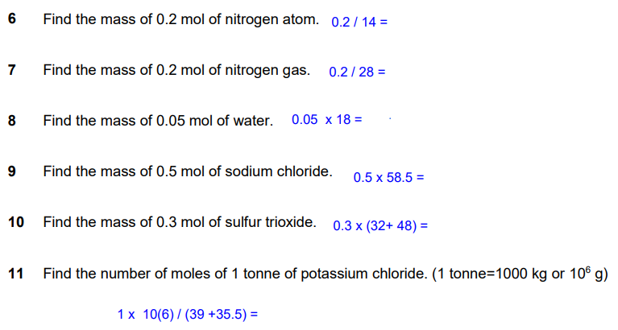

Slide 35
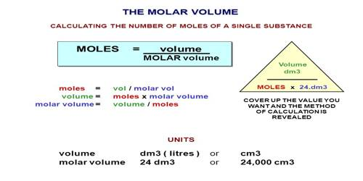

Slide 36
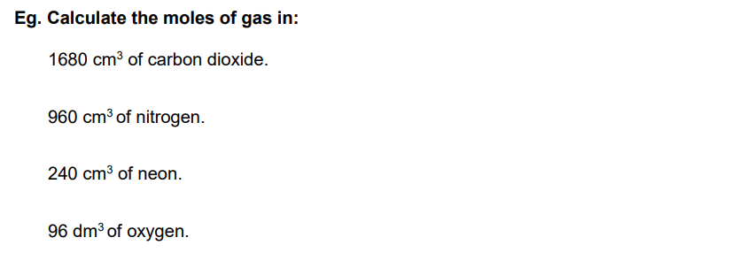

Slide 37
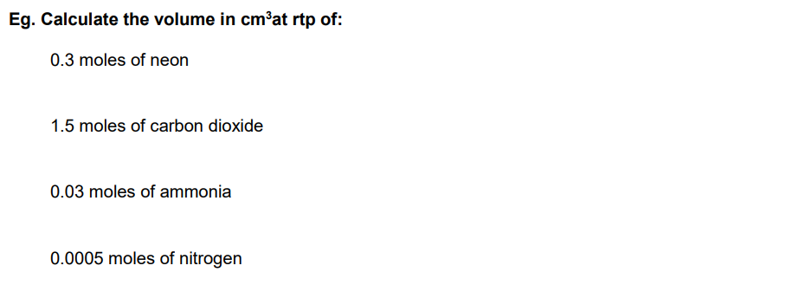

Slide 38
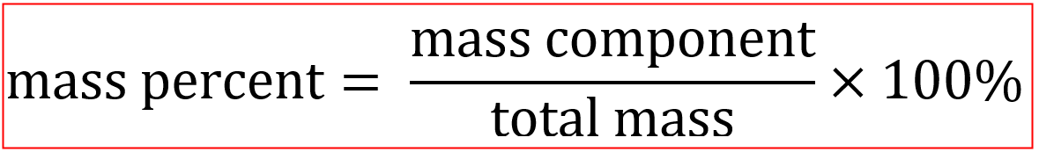
Percentages by mass
Find the percentage by mass of calcium in calcium chloride.
The percentage by mass of calcium in calcium chloride =
=

Slide 39
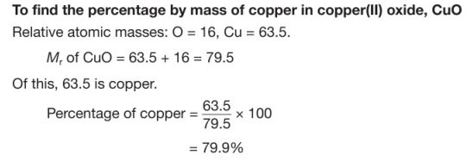


Slide 40

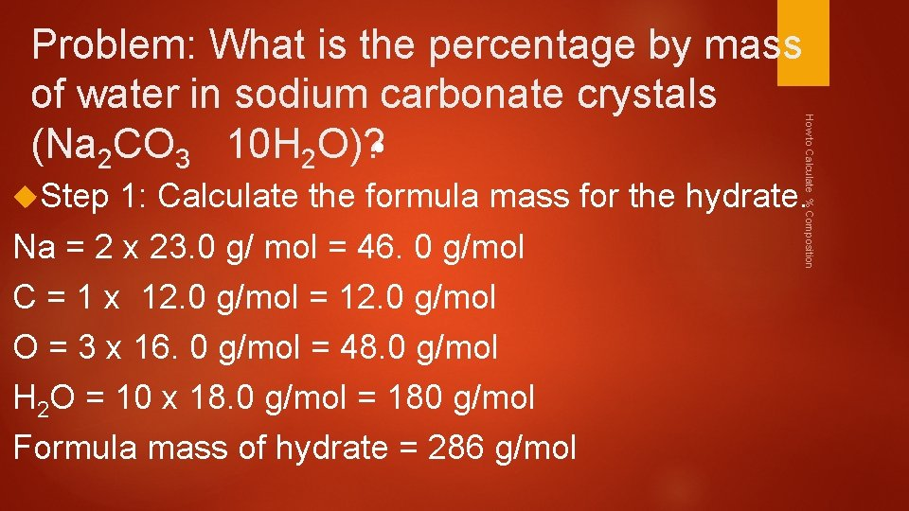
Find the percentage by mass of copper in malachite, CuCO3.Cu(OH)2.
Find the percentage by mass of water in hydrated, MgSO4.7 H2O.
Find the percentage by mass of oxygen in sodium carbonate.

Slide 41
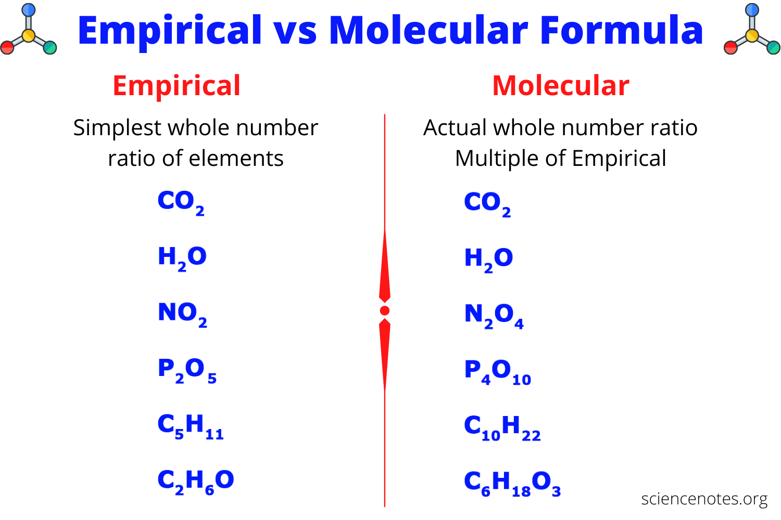

Slide 42
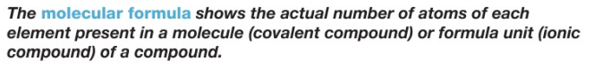
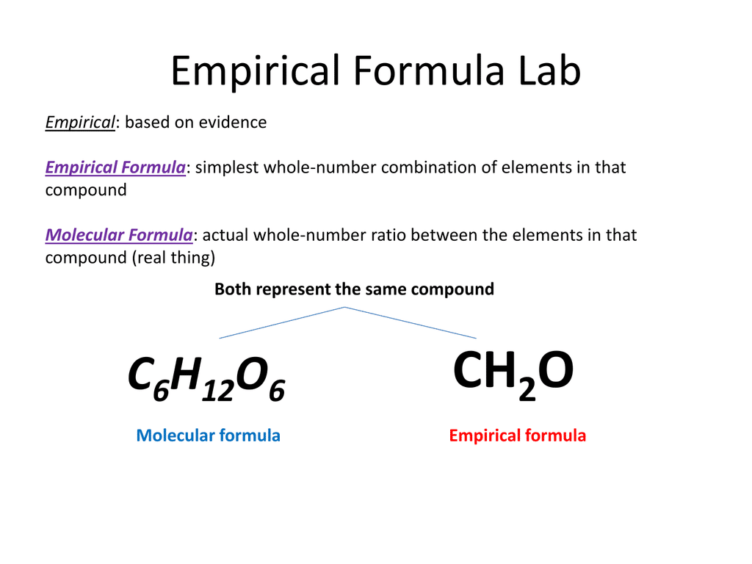

Slide 43
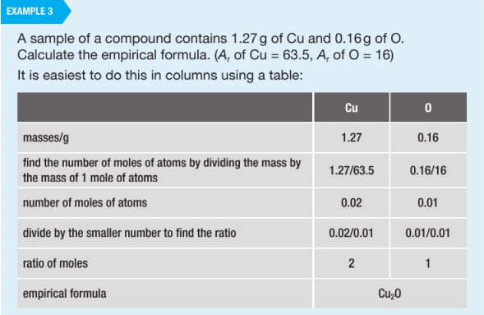

Slide 44
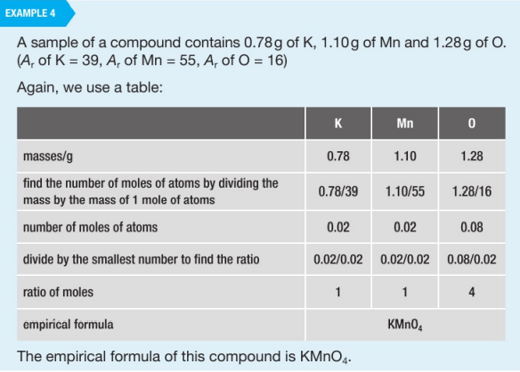

Slide 45
1 .What is the empirical formula of a compound that contains 0.783g of Carbon, 0.196g of Hydrogen and 0.521g of Oxygen?
2. What is empirical formula of a compound which consists of 89.14% Au and 10.80% of O?
3. A hydrate of magnesium sulfate has a mass of 13.52 g. This sample is heated until no water remains. The anhydrous MgSO4 has a mass of 6.60 g. Find the formula and name of the hydrate.
4. A sample of the hydrate of sodium carbonate has a mass of 8.85 g. It loses 1.28 g when heated. Find the formula and the name of the hydrate.

Slide 46
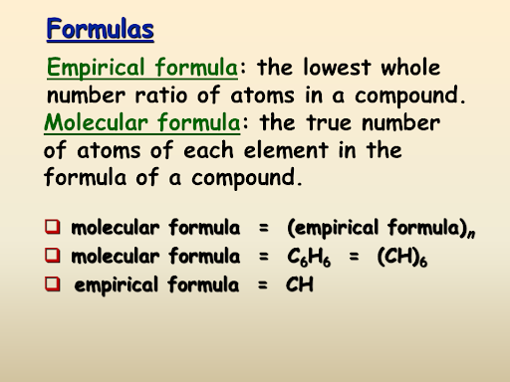
Converting empirical formula to molecular formula
Molecular mass
n=
Simplest mass(empirical mass)

Slide 47
1. A compound is composed of 7.20g of C, 1.20g of H, and 9.60g O. The molar mass of the compound is 180g. Find the empirical and molecular formula for this compound.

Slide 48
2.A compound is composed of 16.66g C and 3.49g H. The molar mass of the compound is 58g. Find the empirical and molecular formulas for this compound.

Slide 49
3.A compound contains 62.0% C, 10.4% H, and 27.5% O. Determine the empirical formula for this compound. After analysis, it was found that the compound’s molar mass is 58.1g. What is the compound’s molecular formula?

Slide 50

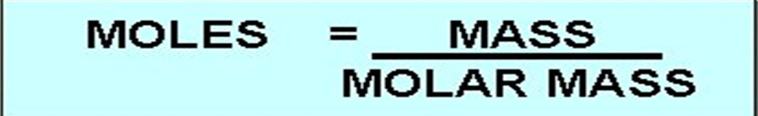
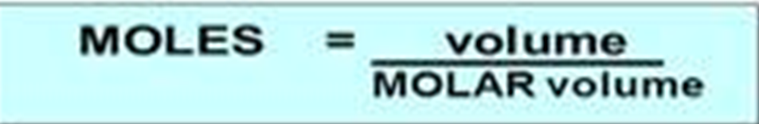
Calculations from equations
1 mole of Al2(so3)3 will react with 6 mole of NaOH to produce 3 mole of Na2SO3 and 2 mole of AL(OH)3.

Slide 51
Calculation from the equations
Calculate the mass of the solid obtained when 16.8 g of sodium hydrogen carbonate is heated strongly until there is no further change.

Slide 52
2. 0.805 g of zinc sulfate was formed when a piece of zinc reacted with excess sulfuric acid. Hydrogen gas was also produced in the reaction. Calculate the mass of zinc used.

Slide 53
3. Ammonia is manufactured by reacting nitrogen with hydrogen. Calculate the volume of nitrogen that reacts with 60 cm3 of hydrogen.

Slide 54

4. Iron is obtained from iron ore, which contains iron (III) oxide. The reaction of iron (III) oxide with carbon monoxide to produce iron. What is the mass of iron produced when 63 dm3 of carbon monoxide reacts completely with iron (III) oxide at rtp?

Slide 55

1 tonne = 1000 000g

Slide 56

Percentage yield
Actual yield: It is the mass of product that is obtained from the experiments.
Predicted yield ( theoretical yield )
it is the mass of the product that is obtained from the mole calculation from the chemical equations.

Slide 57
1. A student reacts 9 g of aluminium powder with excess chlorine. The mass of aluminium chloride produced is 35.6 g. Calculate the percentage yield.

Slide 58
2. When 1.92 g of magnesium was heated in excess oxygen, 3.0g of magnesium oxide was obtained. Calculate the percentage yield of magnesium oxide.

Slide 59


Slide 60



Determination of the limiting substance & excess substance
Limiting reactant: A reactant that is used up during the reaction.
Excess reactant : A reactant that is not used up during the reaction . It is more than enough to react.

Slide 61
Given the following reaction: (Balance the equation first!)
(a) If you start with 14.8 g of C3H8 and 3.44 g of O2, determine the limiting reagent.
(b) the number of moles of carbon dioxide produced =

Slide 62
the number of moles of H2O produced =
mass of H2O produced =
the number of moles of excess reagent ( ) left =
mass of excess reactant ( ) left =

Slide 63

2. Given the following equation:
(a) If 10.0 g of Al2(SO3)3 is reacted with 10.0 g of NaOH , determine the limiting reagent.
(b) the number of moles of Al(OH)3 produced =

Slide 64
(c) the number of moles of Na2SO3 produced =
the number of grams of Na2SO3 produced =
(d) the number of moles of excess reagent ( ) left =
mass of excess reactant ( ) left =

Slide 65
3. Given the following equation:
If 25.4 g of Al2O3 is reacted with 10.2 g of Fe, determine the limiting reagent.
the number of moles of Al produced =
the number of moles of Fe3O4 produced =
mass of Fe3O4 produced =
(d) the number of moles of excess reagent ( ) left =
mass of excess reagent ( ) left =
Homework

Slide 66
4.The reaction between zinc and sulfur produces a large amount of heat, which can be used to proper rockets.
When 13. 0 g of powdered zinc was heated with 8.0 g of powder sulfur, a vigorous reaction occurred and zinc sulfide was formed.
(a) Identify the limiting reactant in this reaction.
(b) Calculate the mass of the excess reactant.

Slide 67
5. Ethene burns in oxygen according to the equation below.
In an experiment, 10 cm3 of ethane was burnt in 50 cm3 of oxygen.
Which gas was supplied in excess?
Calculate the volume of the reactant in excess at the end of the reaction.

Slide 68


Chemical formulae , equation and calculation part (2)

Slide 69



Titrations
Concentration of a solution is the amount of solute in the given volume of solvent.

Slide 70


Slide 71


Slide 72



https://youtu.be/DBeotrAAFQE
https://youtu.be/YqfvRBJ-iPg

Slide 73
Simple titration
Find the mole of 50 cm3 and 2 mol / dm3 of ethanoic acid.
Find the concentration of the salt solution containing the 100g of NaCl and 1000 cm3 of water.(g/dm3)
find the volume of the solvent in cm3 to get 3 mol/dm3 silver solution by using 3 mole of silver.

Slide 74


Slide 75


Slide 76


Slide 77
Titration from equations

Slide 78

1. What volume in cm3 of 0.100 mol/dm3 copper (II) sulfate solution is required to react completely with a solution containing 0.025 mol of sodium hydroxide? The products of reaction are copper (II) hydroxide and aqueous sodium sulfate.

Slide 79

2. Household ammonia solution was analysed to determine its ammonia content. 25.0 cm3 of the ammonia solution required 21.0 cm3 of 0.11 mol / dm3 sulfuric acid to achieve end point of solution. Calculate the concentration of ammonia in g/dm3 in the household ammonia solution.

Slide 80


Slide 81


Slide 82


CHAPTER ENDED QUESTIONS

